Slide 1
AVL Trees Rebalancing Binary Trees

Slide 2
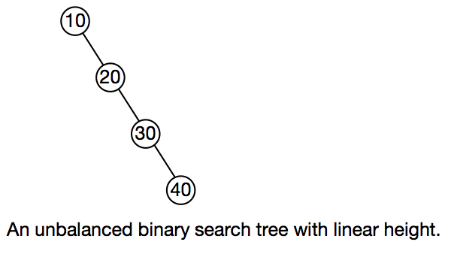
Binary Search Trees can become very unbalanced, depending upon the order in which keys are inserted.
In the worst case, when insertions are made in sorted order, the tree is no better than a linear list.
The tree can be rebalanced as nodes are inserted or removed.
One such tree is the AVL tree, named after its inventors, Adel’son-Vel’skii and Landis
The AVL tree maintains height balance, where the heights of any node’s left and right subtrees differ by no more than 1.

Slide 3
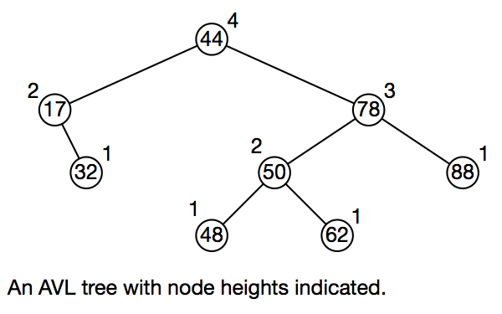

Slide 4
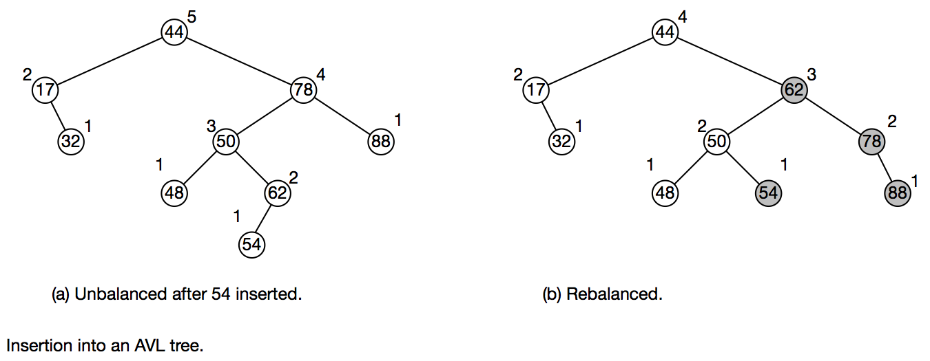

Slide 5
Restructuring By Rotating
Trio of nodes (grandparent, parent, child)
Single rotation
parent and child on same side, both left or both right)
middle of trio (parent) over top of trio (grandparent)
raises child, lowers grandparent
Double rotation
parent and child on different sides, one left, other right)
first: child over parent. raises child, lowers parent
second: parent (rotated child) over grandparent
rotated child becomes grandparent

Slide 6
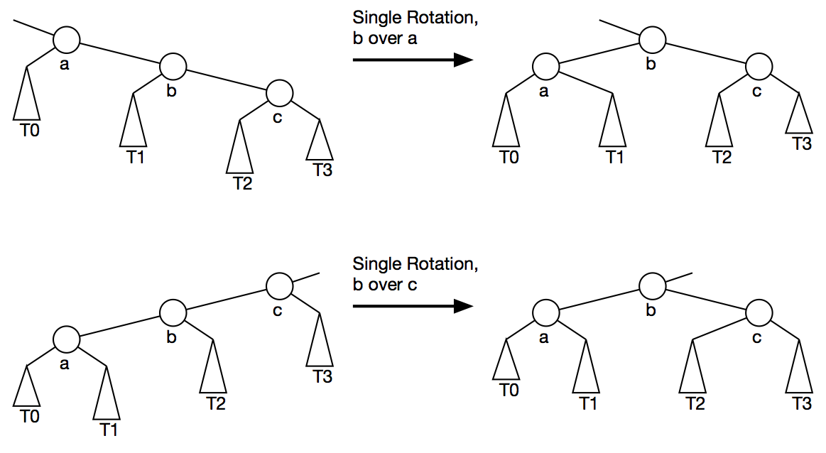

Slide 7
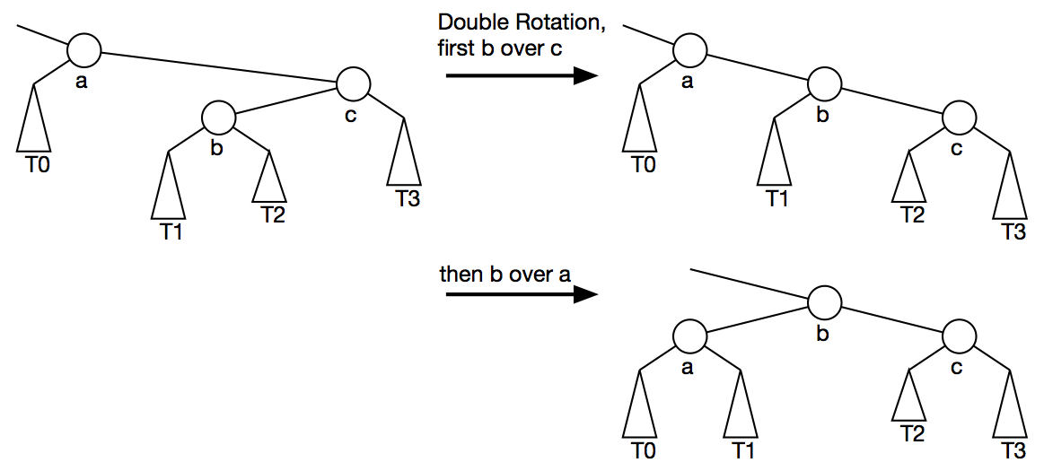

Slide 8
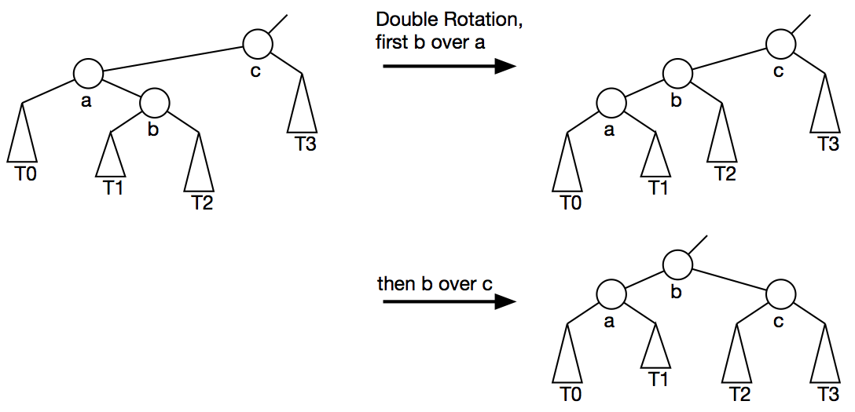

Slide 9
